Slide 1
Choosing the best sales approaches for the new product line
.

Slide 2
Business Goals
To determine the difference in Customers for each sales method.
To determine which sales method the business should continue using.

Slide 3
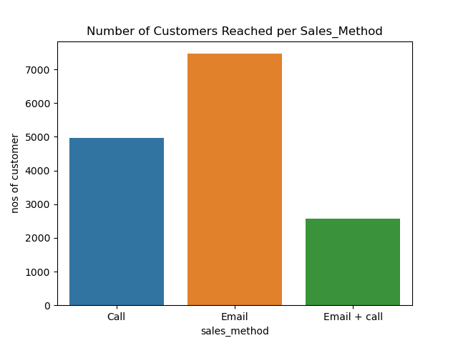
Total Number of Customers Reached by Each Sales Method
From the chart we can observe that most customers were reached using the Email sales method and the least number of customers were reached using the Email + call sales method.
We can see there is no uniformity in the number of customers reached for the 3 sales method.

Slide 4
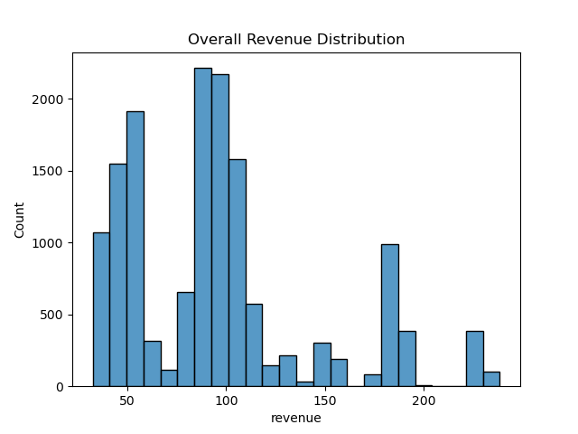
Overall Revenue Distribution
Looking at how the revenues are distributed, most revenue generated were below 120 dollars with an overall mean revenue of 95.58 and median revenue of 90.95 dollars

Slide 5
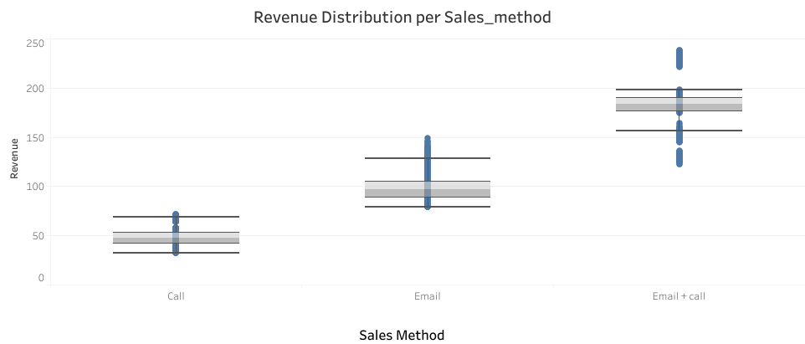
Revenue Distribution For Each Sales Method To understand the difference between customers under each sale method, we would be looking at the revenue distribution under each sales method.
From the boxplot chart, it can be observed that:
The Email + call sales method generated the highest average revenue of 183.7 dollars with the lowest revenue generated by a single client being 122.1 dollars and the highest revenue being 238.2
The Email sales method generated an average revenue of 97.13 with the lowest and highest revenue generated by a single client being 78.80 dollars and 149.0 dollars respectively.
The call sales method generated the least average revenue of 47.60 dollars with the lowest and highest revenue generated by a single client being 32.50 dollars and 71.40 dollars respectively.
We can conclude that customers that fall under the Email + call sales method tend to generate a higher revenue than other methods.

Slide 6
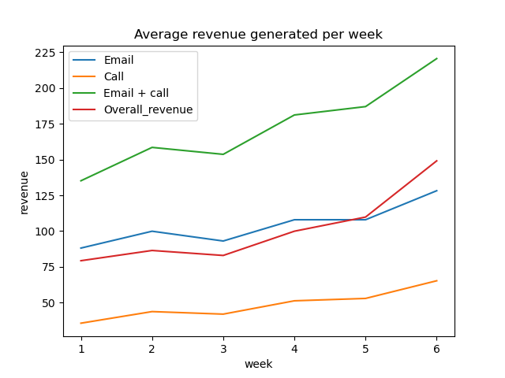
Change in Average Revenue Generated Over Time by Each Sales Method
According to the chart, there is an uptrend in the average revenue generated over the past 6 weeks for each sales method.
The Email + call sales method generated a significantly higher average revenue over time when compared with the overall average revenue generated over time.
The call sales method generated the least average revenue over the past 6 weeks when compared with the overall average revenue generated over the past 6 weeks.

Slide 7
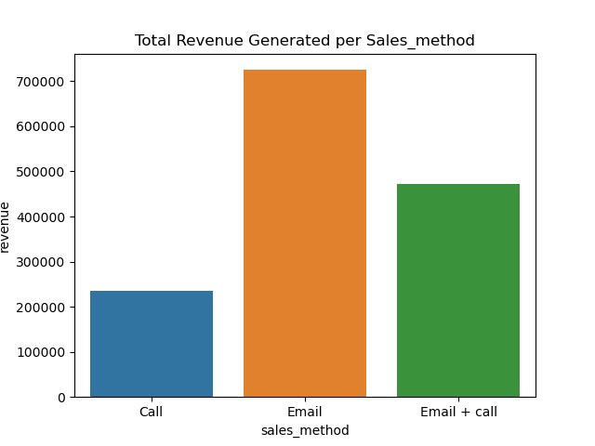
Comparing The Total Revenue Generated by Each Sales Method With The Number of Customers Reached by Each Sales Method
.
From the chart, we can notice that the Email sales method generated the highest total revenue, followed by the Email + call sales method while the Call sales method generated the least amount of total revenue
NOTE:
We should note that although the Call sales method was used to reach more customers than the Email + call sale method, it generated the least total revenue among the 3 sales methods used.

Slide 8
Business Metrics
Since our goal is to determine the difference between the customers in each group and determine the sales method the business should continuously use, I would recommend we use the combination of the average revenue generated by each sales method, the total number of customers reached by each sales method and the total revenue generated by each sales method as our metrics.
Based on the 6 weeks data the least number of customers were reached using the Email + call sales method yet it had the best performance In terms of the average revenue generated and second best in terms of total revenue generated.
The Email sales method was used to reach most customers, it performed second best in terms of average revenue generated and was the best-performing method in terms of total revenue generated.
The Call sales method performed the least in all aspects, even though it was used to reach more customers than the Email + call sales method.
It can be concluded that the Email + call sales method and the Email sales method are the best sales method for the business.

Slide 9
Recommendation
Since there are no similarities in the result generated from each sales method, I would recommend the following:
The sales team should continuously use the Email + call sales method and come up with a strategy that would make this method less time-consuming so it could be used to reach more customers since it has an outstanding performance based on our metrics.
The business should continue using the Email sales method since it is the fastest way to reach customers and has a good performance based on our key metrics and the sales team should improve on this method if need be.
The sales team should focus less on the Call sales method and shift some of its focus to the Email + call sales method.
Improve the data quality, by providing a data set with an equal number of customers reached by each sales method so that in-depth analysis can be done to draw a stronger conclusion on the best sales method.

